Slide 1


SOCIAL CAPITAL ANALYTICS
UNEARTHING ECONOMIC CONNECTEDNESS

Slide 2





MEET THE TEAM
DAVID NGUYEN
AUSTIN SWEENEY
HUNTER VAZIRIAN
ASHLEY CAO
CARLOS MOLINA

Slide 3
01
02
03
04
Data Overview
Methodology
Insights
Recommendations

Slide 4



01
SOCIAL CAPITAL
Data Overview

Slide 5

Economic Connectedness
01
The extent to which people with different characteristics are friends with each other. This includes our main economic connectedness measure
SOCIAL CAPITAL
Data Overview
Cohesiveness
The degree to which friendship networks are clustered into cliques and whether friendships tend to be supported by mutual friends. This includes our clustering and support ratio measures
Civic Engagement
Indices of trust or participation in civic organizations. This includes our volunteering rate measure

Slide 6
01
Data Overview
SOCIAL CAPITAL
Economic Connectedness
Upward Mobility
The extent to which people with different characteristics are friends with each other. This includes our main economic connectedness measure
Ability of individuals or groups to improve their socioeconomic status or position in society over time, often through education, career advancement, or financial success

Slide 7
01
02
03
04
Data Overview
Methodology
Insights
Recommendations

Slide 8

02
: ROADMAP
Methodology
Data Preprocessing
Results
Using machine learning and visualization to demonstrate to correlation between connectedness and upward mobility
Handling missing values, dropping specific columns, finding target variable
Data Understanding
Model Development
Recommendation
What is social capital? What is economic connectedness? How does it affect upward mobility?
Using Linear Regression Model to analyze target variable within county dataset
Solutions to maximize connectedness and improve upward mobility

Slide 9
01
02
03
04
Data Overview
Methodology
Insights
Recommendations

Slide 10

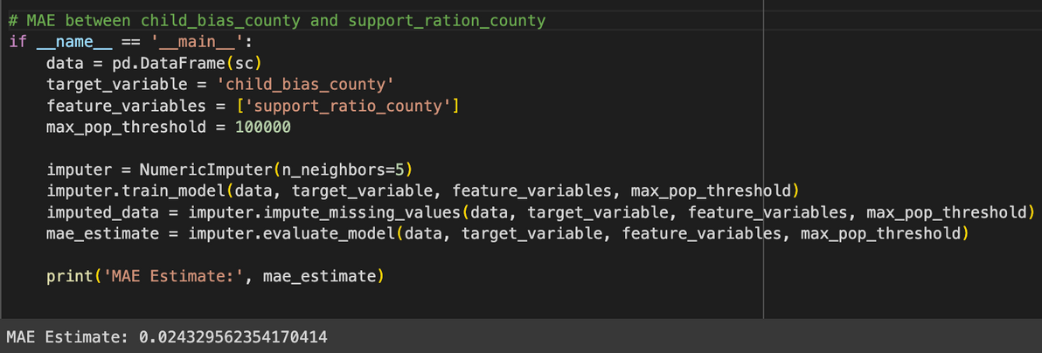
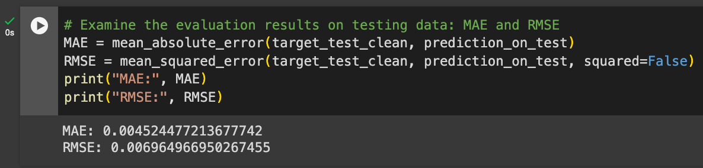
KNN REVEALED SUPPORT RATIO HAD VERY STRONG PREDICTIVE CAPABILITIES ON CHILD BIAS
03
Insights

Slide 11
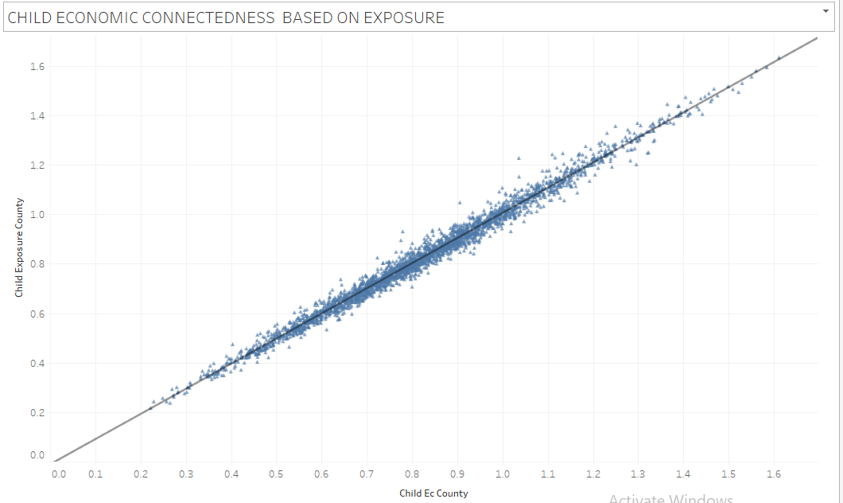
For every one-unit increase in ‘child_exposure_county’, there is an increase of approximately 0.9992 units in the ‘child_ec_county’, assuming all other variables are held constant.
In other words, how often a student interacts with high-SES people will directly increase their upward social mobility
03
Insights

Slide 12
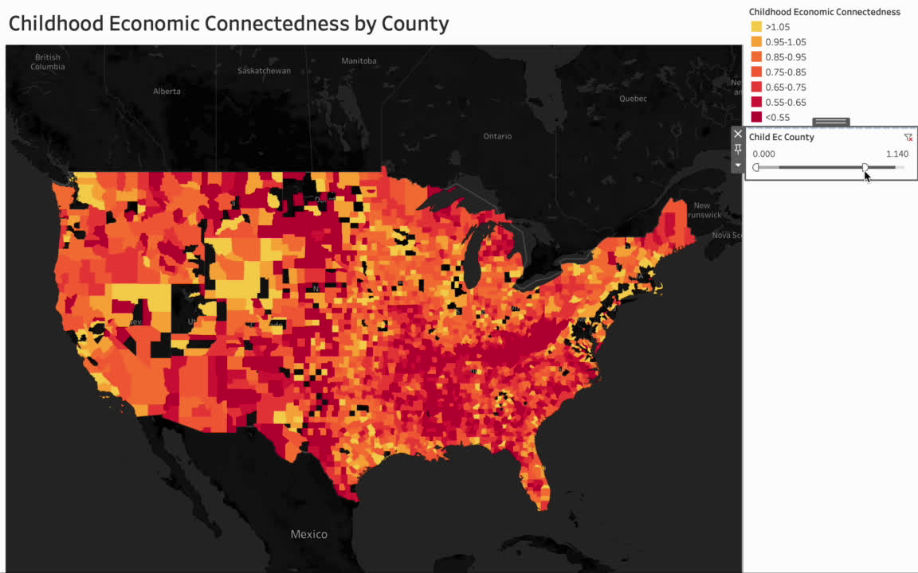
03
Insights

Slide 13
01
02
03
04
Data Overview
Methodology
Insights
Recommendations

Slide 14

FUTURE PLANS
Change how we group and structure children in settings like schools
Policy changes focused on social structures could influence friendship patterns and potentially promote cross-class interaction
Create programs and venues for cross-socioeconomic interaction
Policies creating opportunities for meaningful interaction across socioeconomic groups can reduce friending bias and promote individual and community benefits
Focusing on interventions that strengthen social capital can have a significant impact on economic mobility.
04
Recommendations
Notes:
Need redristicting
Invest in gifted programs in lower income areas such as IB, AP, and gate
Districts need to convert as many of their schools into magnets
Essentially, investment is required to transform educational institutions and elevate them in order to give students the diverse environment needed to create

Slide 15

THANK YOU

